Slide 1
Business and Industrial Economics
Prof. Luca Grilli
Industrial and competition policy: an introduction

Slide 2
Public Policy towards business
Micro and not macro perspective (e.g. monetary policy and/or general fiscal policy)
Industrial Policy
Competition policy
Regulation
Antitrust

Slide 3
Business and Industrial Economics
Prof. Luca Grilli
Industrial Policy: classification

Slide 4
Definitions (among many others)
“Industrial Policy is a nation’s official total effort to influence sectoral development and thus, the national industrial portfolio” (Bingham in Handbook of public policy, edited by B. Guy Peters and Jon Pierre, 2006, SAGE, p. 293).
“Any type of selective intervention or government policy that attempts to alter the structure of production toward sectors that are expected to offer better prospects for economic growth than would occur in the absence of such intervention, i.e., in the market equilibrium.” (Pack and Saggi 2006).
“Industrial policy means the initiation and coordination of governmental initiatives to leverage upward the productivity and competitiveness of the whole economy and of particular industries in it.” (Johnson 1984)

Slide 5

Industrial Policy definition: A more general one
“Industrial policy is any policy that affects a subset of firms, firms’ activities and industries differentially from the remaining group of firms, firms’ activities and industries. Any tax, subsidy, trade and other policy measure that affects only a limited and specific domain of a nation’s production system can be considered as an industrial policy intervention.”
Grilli (2015):
Examples:
Examples:
Support to young innovative companies (L. 221 Italy 2012, MISE)
(Some elements of) Italian PNRR (Italy’s National Recovery and Resilience Plan). See Lucchese & Pianta (2021, in Moneta e Credito, vol. 74 (294), 177-190)
3) Sustainment to specific sectors (e.g. Automobile industry)
-Import quota (or other trade restrictions) imposed by the Government to protect the national industry
-Government subsidy (or guaranteed low interest rate loan) for buying new (eco-friendly) cars
-The set-up of a new public research center on autonomous self-driving car innovations in partnership with private operators

Slide 6
Industrial Policy: a complex wor(l)d
a) Different types:
offensive (support to specific industries able to play a major role on the global value chains, e.g. “smart specialization”) and defensive (“protectionism”, “save losers” or “sunset industries”) policies, where defensive in the short-tem may become offensive in the long-run (successful “infant industries” policies).
2) Horizontal vs. vertical industrial policies
b) Different rationales: economics (e.g. market failures), social justice or avoidance of social problems (e.g. employment safeguard), national strategic aims (e.g. “national champions” policies), etc.
c) Different outcomes: Political and lobbying influence [see public choice theory, Buchanan 2003], “Government failures” [apart from lobbying activities, i.e. often effectiveness of policies depends “on get the implementation details right”, and this may be tricky details (Duflo, 2017)]

Slide 7
Social welfare
Allocative efficiency
Productive efficiency
Static efficiency
Dynamic efficiency

Slide 8
Policy-making and Efficiency
Allocative efficiency
Productive efficiency
Dynamic efficiency

Slide 9
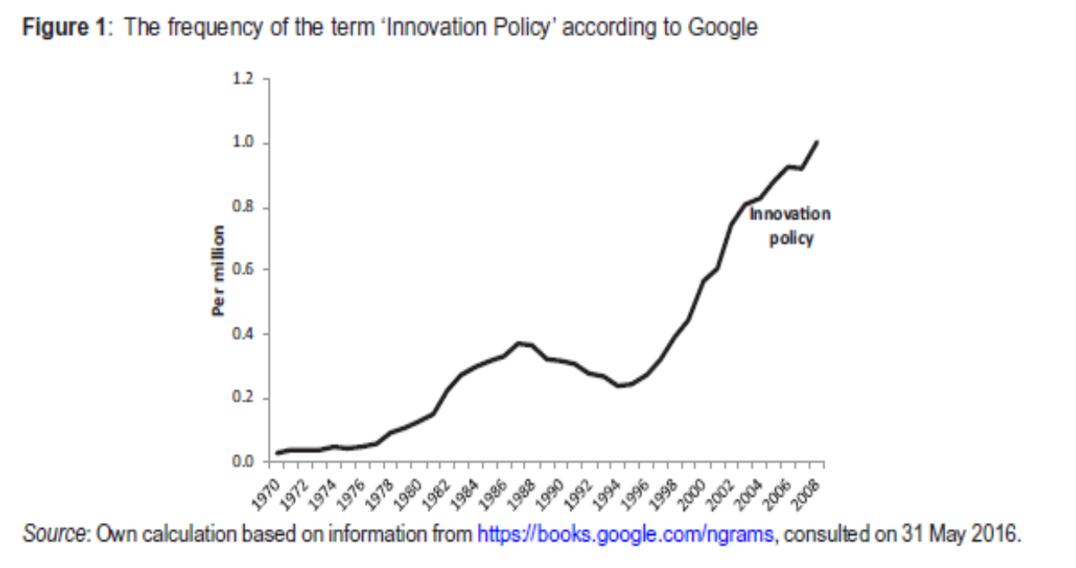
Our (deliberately limited) perspective
Focus on Innovation Policy (Industrial Policy, at least in its “offensive” component is more and more coincident with its subset of Innovation Policy): e.g. Italy: Start-up Act, Industry 4.0 Plan, PNRR.
From the Lecture on innovation: “INNOVATION has become the industrial religion of the late 20th century. Business sees it as the key to increasing profits and market share. Governments automatically reach for it when trying to fix the economy.” The Economist”, February 20th 1999, Survey of Innovation in Industry
Edler & Fagerberg, 2017, Innovation policy: what, why, and how, Oxford Review of Economic Policy, vol. 33 (1), pp. 2-23.

Slide 10
[slide from Lecture on Innovation]
PUBLIC POLICY
Mkt structure
Innovation

Slide 11
Has public policy a role in the whole innovative process?
Of course yes and of course yes at multiple levels. The innovative activity in economy is strongly influenced by several forces, including competition policy, regulatory and law regimes, patent system (among others) all contribute to shape the interested dynamics. Without forgetting the institutional context (e.g. see Baumol, 1990, on this latter aspect on JPE)

Slide 12
Baumol’s thesis (in a nutshell and simplifying a bit)
“Entrepreneurial talent” available can vary across different economic systems of different times, but let’s say not that much.
Are “institutions”, i.e. both formal (i.e. laws, rules, regulation, written norms) and informal institutions (i.e. culture, common habits, unwritten norms, tacit codes of conduct) and the way these two type of institutions interact (i.e. “the institutional matrix”, North, 1990) which set the “rules of the game” in life for individuals (and entrepreneurs), and in doing so channel this “entrepreneurial talent” towards productive, unproductive or destructive activities (from a social welfare point of view).
Baumol provides multiple examples in different ages (see the “Great Classics” folder on the WeBeep site). Including the following:
“There is a story, repeated by a number of Roman writers, that a man-characteristically unnamed-invented un-breakable glass and demonstrated it to Tiberius in anticipation of a great reward. The emperor asked the inventor whether anyone shared his secret and was assured that there was no one else; whereupon his head was promptly removed, lest, said Tiberius, gold be reduced to the value of mud. I have no opinion about the truth of this story, and it is only a story. But is it not interesting that neither the elder Pliny nor Petronius nor the historian Dio Cassius was troubled by the point that the inventor turned to the emperor for a reward, instead of turning to an investor for capital with which to put his invention into production?” (Finley 1965, Economic History Review, p. 32)

Slide 13
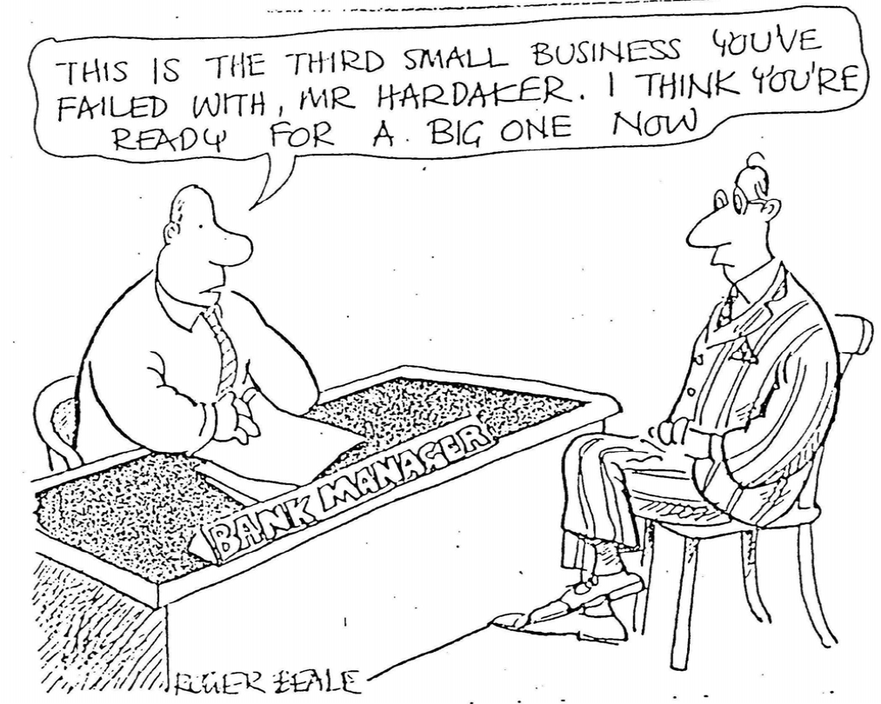
Another example (mine): Failing in the US

Slide 14
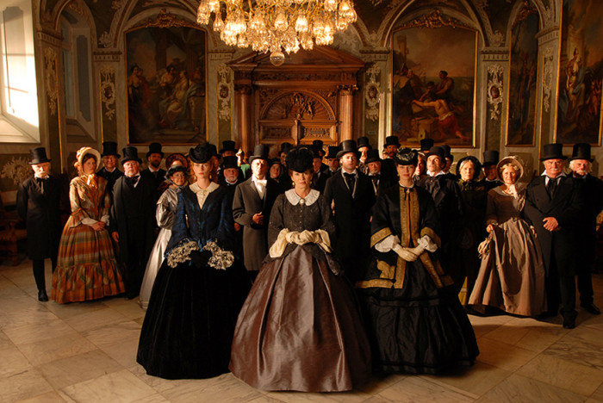
Failing in the EU
From “The Buddenbrook” by Thomas Mann (1900):
"Grünlich is bankrupt?" Tony asked under her breath, half rising from the cushions and seizing the Consul's hand quickly."Yes, my child," he said seriously.
“[….] "Oh, my God!" she suddenly uttered, and sank back on her seat. In that minute all that was involved in the word "bankrupt" rose clearly before her: all the vague and fearful hints which she had heard as a child. "Bankrupt" — that was more dreadful than death, that was catastrophe, ruin, shame, disgrace, misery, despair. "He is bankrupt" she repeated.

Slide 15
Focus (next lecture)
Combination of normative and positive arguments with a focus on direct support for private R&D expenditure

Slide 16
References (Industrial Policy)
Reading material (purely optional, not mandatory):
Pack, H., & Saggi, K. (2006). The case for industrial policy: a critical survey. The World Bank (https://openknowledge.worldbank.org/bitstream/handle/10986/8782/wps3839.pdf)
Duflo, E. (2017). Richard T. Ely lecture: The economist as plumber. American Economic Review, 107(5), 1-26.

